Slide 1
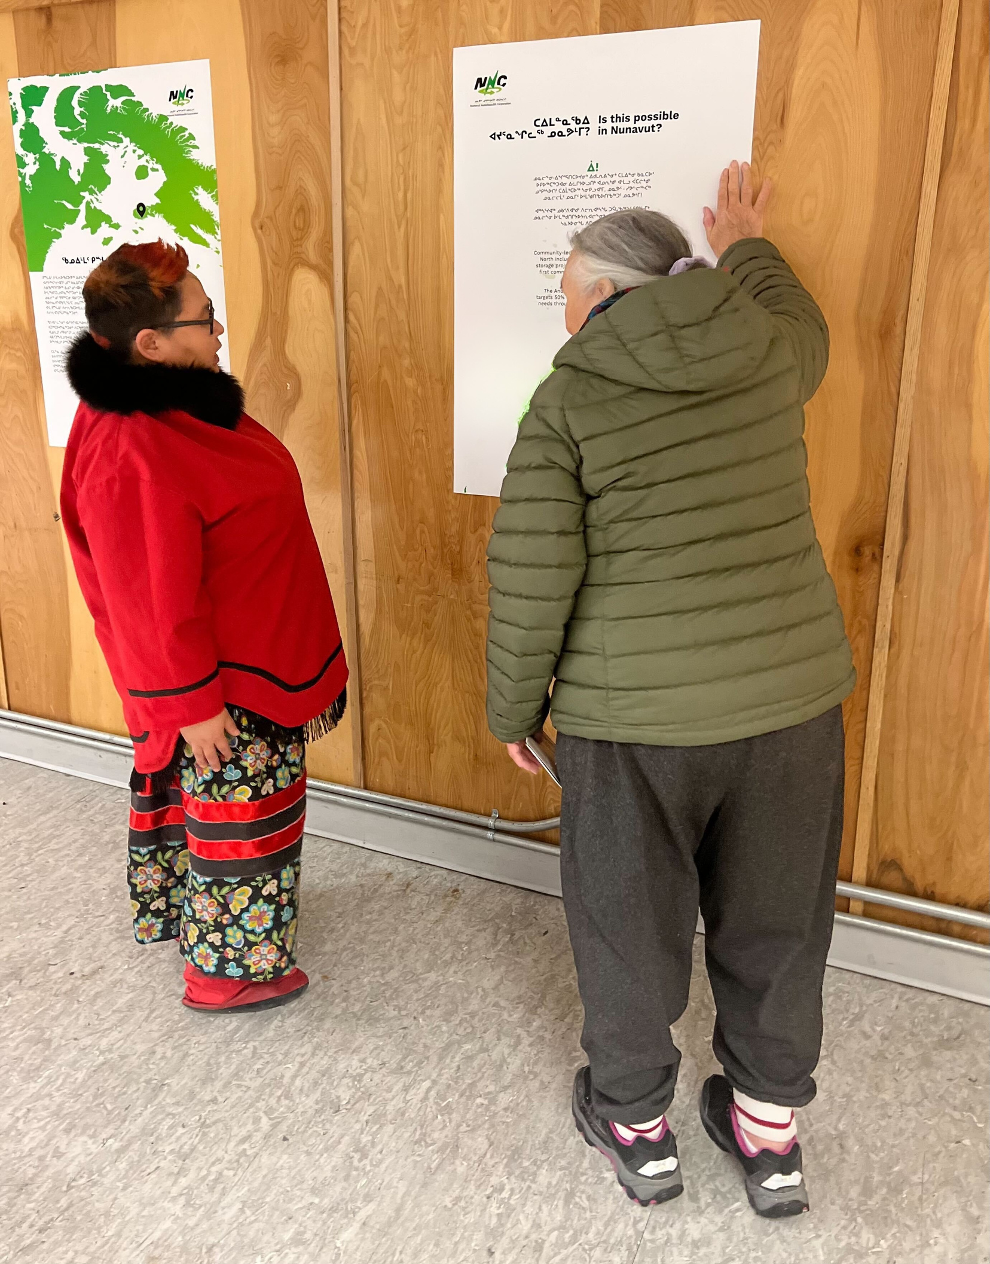


ᐃᖃᓗᐃᑦ ᓄᑭᒃᓴᐅᑏᑦ ᓴᓇᔭᐅᓂᖓ
IQALUIT NUKKIKSAUTIIT PROJECT
ᓈᓚᖕᓂᖅ, ᑐᑭᓯᓇᑦᑎᐊᕐᓂᖅ, ᐊᒻᒪᓗ ᑐᑭᓯᐅᒪᓂᖅ
Listening, Clarity and Understanding
ᔭᓄᐊᕆ 2026
January 2026

Slide 2
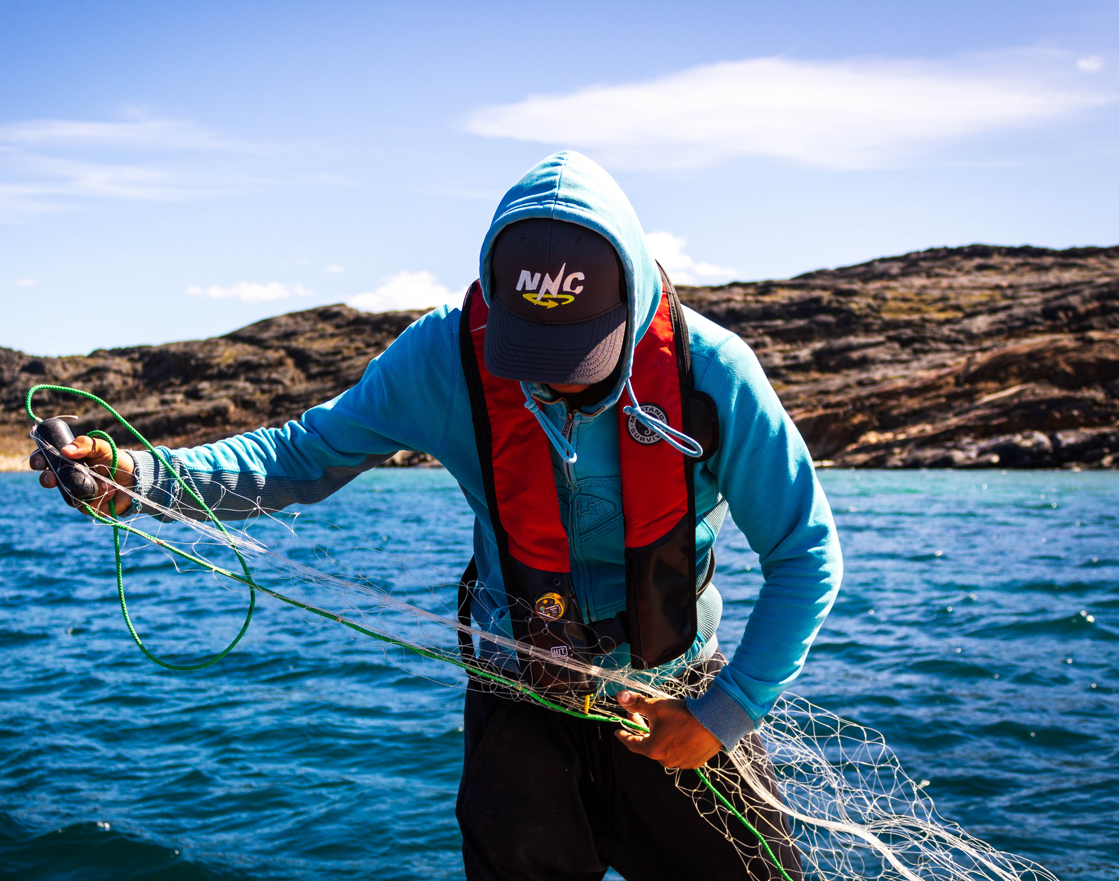

ᑭᓇᐅᖕᒪᑦ ᓄᓇᕗᑦ ᓄᒃᑭᓴᐅᑏᑦ ᑯᐊᐳᕇᓴᒃᑯᑦ?
WHO IS NNC?
ᐃᓄᖕᓄᑦ−ᓇᖕᒥᓂᕆᔭᐅᕗᒍᑦᑲᒻᐸᓂᒋᔭᐅᓪᓗᑕᓴᖅᑭᑎᑦᑎᕙᒃᑐᓂᒃᐆᒻᒪᖅᑯᒻᒥᒃᐊᑐᖅᐸᒃᖢᑎᒃᐊᓯᔾᔨᒋᐊᒐᒃᓴᐅᔪᒥᒃᐆᒻᒪᖅᑯᒻᒥᒃ, ᐃᓚᒋᔭᐅᓪᓗᓂᐊᓄᕆᒧᑦ,
ᐃᒪᕐᒧᑦᓯᕿᓂᕐᒧᓪᓗᐆᒻᒪᖅᑯᓯᐅᕐᓂᕐᒧᑦᐊᑐᖅᑕᐅᓕᖅᐸᒃᑐᓂᒃ.
ᓇᒻᒥᓂᕆᔭᐅᒐᑦᑕᕿᑭᖅᑖᓗᒃᑯᐊᐳᕇᓴᓐᑯᓐᓄᑦ, ᑕᐃᒪᐃᒻᒪᑦ, ᐱᓕᕆᖃᑦᑕᖅᑐᒍᑦᐃᑲᔫᑎᖃᕐᓂᐊᖅᑐᓂᒃᕿᑭᖅᑕᓂᐃᓄᓐᓄᑦᓄᓇᓕᓐᓄᓪᓗ.
We are an Inuit-owned company that produces electricity using renewable energy, including wind, water, and solar energy sources.
We are wholly-owned by Qikiqtaaluk Corporation; therefore, we work for the benefit of Qikiqtani Inuit and communities as a whole.
Notes:
NNC was created in 2017 in response to the desire of Qikiqtani communities to transition away from diesel and explore renewable energy options. We develop Inuit- and community-led renewable energy projects that advance energy security and Inuit sovereignty in Nunavut.

Slide 3
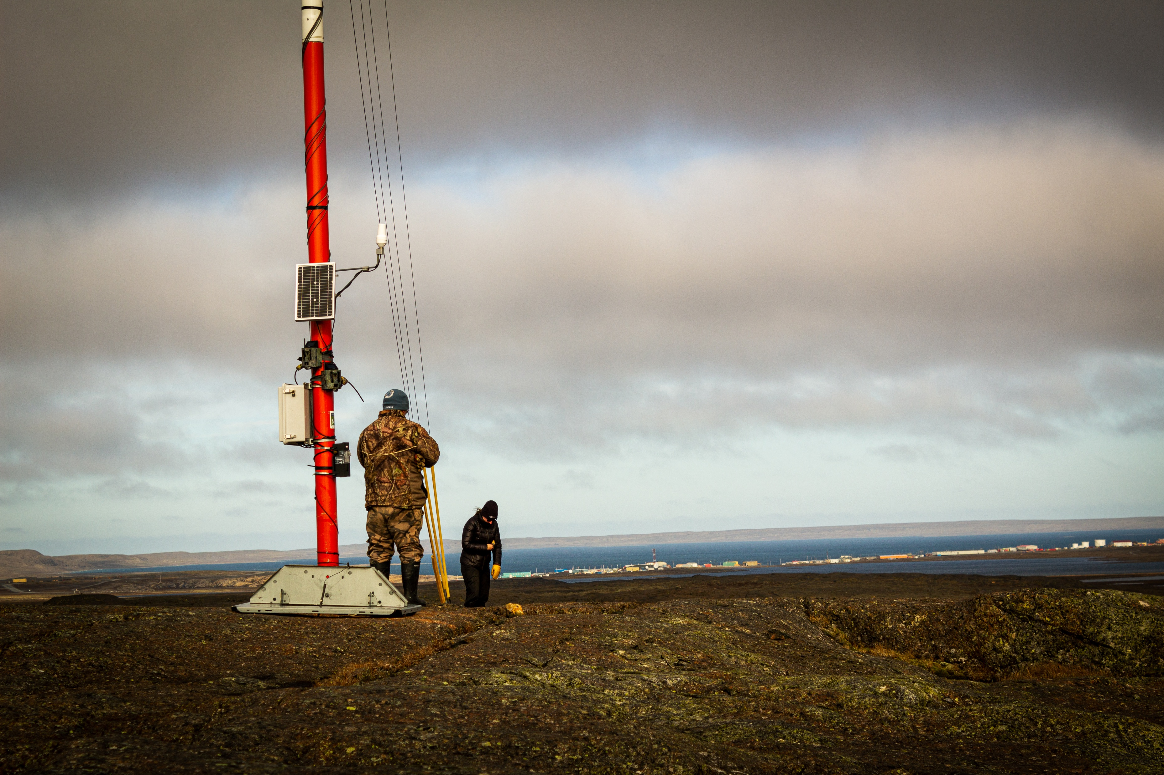
ᖃᓄᐃᒻᒪᑦ ᐆᒻᒪᖅᑯᑎᓂᒃ ᐊᑐᒃᑲᓐᓂᕈᓐᓇᖅᑐᑦ?
WHY RENEWABLE ENERGY?
ᐃᓄᐃᑦ ᐃᓅᓯᖃᐃᓐᓇᐅᔭᖅᐳᑦ ᓇᓕᒧᒌᒃᑎᑦᑎᓂᕐᒥᒃ ᓄᓇᒥᒃ, ᑲᓯᐅᖅᑕᐅᓪᓗᓂ ᖃᐅᔨᒪᓂᕆᔭᐅᔪᒧᑦ ᓯᓚᒧᑦ, ᐃᒪᕐᒧᑦ, ᓯᑯᒧᑦ, ᐆᒪᔪᓄᒡᓗ.
ᐊᑐᒃᑲᓐᓂᕈᓐᓇᖅᑐᑦ ᐆᒻᒪᖅᑯᑏᑦ ᐊᒃᑐᐊᓂᖃᖅᐳᑦ ᑖᒃᖁᓂᖓ ᐱᒻᒪᕆᐅᒋᔭᐅᔪᓂᒃ ᐃᒪᕐᒧᑦ, ᐊᓄᕆᒧᑦ, ᐊᒻᒪ ᓯᕿᓂᕐᒧᑦ ᐊᑦᑕᕐᓇᖅᑐᓂᒃ ᐅᖅᓱᐊᓗᖕᒨᖅᑐᓂᒃ ᒥᒃᖠᒋᖓᖅᑎᑦᑎᙱᖔᕐᓗᑎᒃ ᓱᕈᕐᓇᖅᑐᓂᒃ ᓴᐳᔾᔨᓗᑎᒡᓗ ᐃᓄᐃᑦ ᓄᓇᖏᓐᓂᒃ ᓂᕿᒋᕙᒃᑕᖏᓐᓂᒡᓗ.
ᐃᑲᔪᖅᑐᐃᕗᖅ ᐃᓄᐃᑦ ᓇᖕᒥᓂᖅᓱᕈᓐᓇᕐᓂᖏᓐᓂᒃ, ᓄᓇᓕᖕᓄᑦ ᐱᕚᓪᓕᕈᑕᐅᕙᒃᑐᓂᒃ, ᓴᐳᔾᔨᓯᒪᓪᓗᓂᓗ ᓄᓇᒥᒃ ᑭᖑᕚᒃᓴᑦᑎᓐᓄᑦ.
Inuit have always lived in balance with the land, guided by knowledge of weather, water, ice, and wildlife.
Renewable energy reflects these values by working with water, wind, and sunlight instead of harmful diesel—reducing pollution and protecting Inuit land and food systems..
It supports Inuit self-reliance, community benefits, and protects the land for future generations.

Slide 4

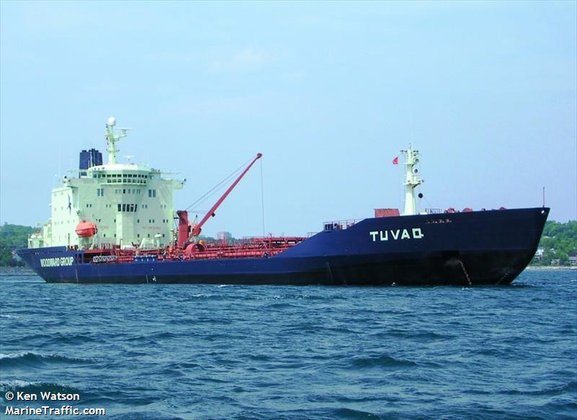







ᒫᓐᓇ ᖃᓄᐃᓕᖓᓕᖅᑲ?
WHAT IS THE CURRENT STATE?
ᓄᓇᕐᔪᐊᕐᒥ ᐅᖅᓱᐊᓗᒃ ᓂᐅᕐᕈᑕᐅᔪᑦ
ᐅᖅᓱᐊᓗᒃᑕᕐᓂᖅ (1/3)
ᐅᖅᓱᐊᓗᓕᐅᕐᕕᒃ (1/3)
ᐃᖅᑲᓇᐅᔭᐅᑏᑦ/ᑖᒃᓰᔭᕈᑏᑦ (1/3)
ᒪᓕᒐᓕᐅᖅᑕᐅᓯᒪᙱᑦᑐᖅ
ᐆᒻᒪᖅᑯᑎᑦ
Energy
Global Oil Market
Oil extraction (1/3rd)
Oil Refinery (1/3rd)
Logistics/taxes (1/3rd)
Unregulated
ᐊᑭᖓ
Money
ᐅᖅᓱᐊᓗᖕᒧᑦ ᐃᑲᔫᑎᑦ
Fuel Subsidy

Slide 5





ᑭᓲᕙ ᓯᕗᓂᒃᓴᒥ ᖃᓄᐃᓕᖓᓂᖓ?
WHAT IS THE FUTURE STATE?
ᓄᓇᓕᖕᓂ ᓄᓇᒥᐅᑕᑦ
ᐆᒻᒪᖅᑯᑎᖃᖅᑎᑦᑎᓗᓂ ᖁᓪᓕᖅ ᐆᒻᒪᖅᑯᑎᓕᕆᔨᒃᑯᑦ ᑎᒥᖁᑖᓄᑦᓄᓇᓕᖕᓂ ᐃᒡᓗᕐᔪᐊᑦ ᐊᐅᓚᓂᕆᔭᖏᑦ
ᓄᓇᓕᖕᓂ ᐃᒡᓗᕐᔪᐊᑦ ᐊᐅᓚᓂᕆᔭᖏᑦ
ᑲᓇᑕᐅᑉ ᓯᓚᑖᓂᙶᖅᑐᓂᒃ ᑎᑭᑎᑦᑎᔭᕆᐊᖃᙱᑦᑐᖅ
ᐆᒻᒪᖅᑯᑎᑦ
Energy
ᐊᑭᖓ
Money
Local Renewables
Sell power to QEC
Local facility operations
No imports required

Slide 6
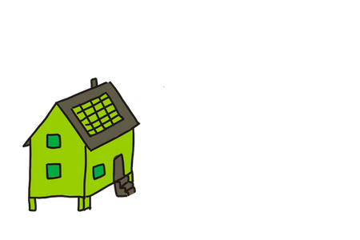



ᖃᓄᖅ ᑐᑭᖃᖅᐸ ᑮᓇᐅᔭᖃᕐᓂᖅᓴᐅᓕᕐᓂᖅ ᓄᓇᕗᑦᒥ?
WHAT DOES MORE MONEY IN NUNAVUT MEAN?
ᒫᓐᓇᐅᔪᖅ, ᓄᓇᕗᑦ ᒐᕙᒪᒃᑯᖏᑦ ᐊᑐᖅᑐᑦ 10 ᒥᓕᐊᓐ ᑖᓚᓂ ᐃᑲᔫᑎᒃᓴᓄᑦ ᐅᖅᓱᐊᓗᑐᐃᓐᓇᕐᒧᑦ ᐆᒻᒪᖅᑯᑎᓄᑦ.
ᓄᒃᑎᕈᑦᑕ ᐆᒻᒪᖅᑯᑎᓄᑦ ᐊᑐᒃᑲᓐᓂᕈᓐᓇᖅᑐᓄᑦ, ᑮᓇᐅᔭᐃᑦ ᐊᑐᖅᑕᐅᖔᕈᓐᓇᖅᐳᑦ ᐃᓐᓇᕐᓄᑦ ᑲᒪᒋᔭᐅᓂᖏᓐᓄᑦ, ᐋᓐᓂᐊᖅᑐᓕᕆᓂᕐᒧᑦ, ᐃᓕᓐᓂᐊᖅᑐᓕᕆᓂᕐᒧᑦ, ᐃᒡᓗᓕᕆᓂᕐᒧᑦ, ᓂᕿᖃᑦᑎᐊᕐᓂᕐᒧᑦ, ᐊᓯᖏᓐᓄᓪᓗ ᐊᑐᕆᐊᓕᖕᓄᑦ.
ᐃᒡᓗᓕᕆᓂᖅ
HOUSING
ᓂᕿᖃᑦᑎᐊᕐᓂᖅ
FOOD SECURITY
Right now, the Government of Nunavut is spending tens of millions of dollars on subsidizing diesel power.
If we switch to renewable energy, that money can instead be spent on Elders care, health care, education, housing, food security, and other pressing needs.
ᐃᓕᓐᓂᐊᕐᓂᖅ
EDUCATION
ᐋᓐᓂᐊᖅᑐᓕᕆᓂᖅ
HEALTH CARE

Slide 7
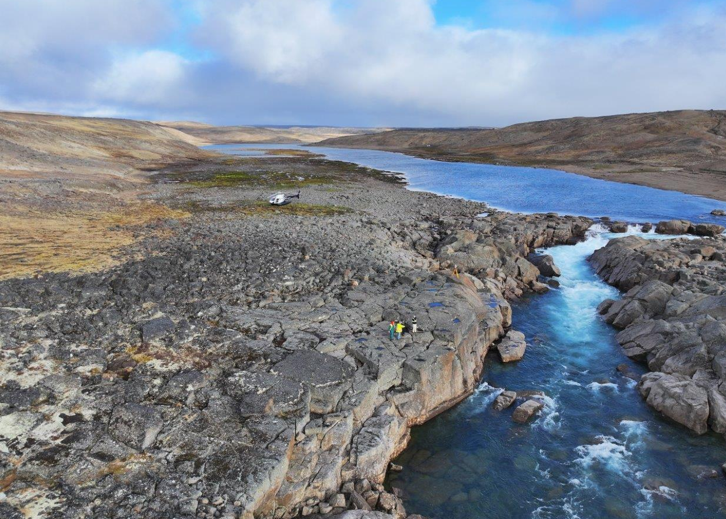
ᐃᖃᓗᐃᑦ ᓄᑭᒃᓴᐅᑏᑦ ᓴᓇᔭᐅᔪᖅ
IQALUIT NUKKIKSAUTIIT PROJECT
ᐃᖃᓗᖕᓂ ᓄᒃᑭᒃᓴᐅᑏᑦ ᐱᓕᕆᐊᖅ ᐊᓯᔾᔩᔪᓐᓇᕐᒪᑦ ᓄᓇᕗᑦᒥ ᐆᒻᒪᖅᑯᑎᖃᖅᑎᑦᑎᓂᕐᒥᒃ ᓄᓇᕗᑦᒥ ᓯᕗᓪᓕᖅᐸᐅᓪᓗᓂ ᐃᒪᕐᒧᑦ ᐊᐅᓚᑕᐅᔪᖅ ᐆᒻᒪᖅᑯᑎᓄᑦ ᐱᓕᕆᐊᖅ. ᑭᖑᕝᕕᐅᑎᔪᓐᓇᖅᑐᖅ ᐅᖅᓱᐊᓗᑐᐃᓐᓇᕐᒧᑦ ᐃᖃᓗᖕᓂ ᐆᒻᒪᖅᑯᑎᒋᔭᐅᓪᓗᓂ.
ᐱᓕᕆᐊᖅ ᑐᒃᓯᕋᖅᑐᖅ ᐃᒪᒃᑯᑦ ᐆᒻᒪᖅᑯᑎᖃᕐᕕᒃᓴᒥᒃ ᑰᖕᒥᑦ ᑰᒑᓗᒃᒥᑦ, 60 ᑭᓛᒥᑐᐸᓗᖕᓂᑦ ᐅᐊᖕᓇᖅᐸᓯᐊᓂ ᐃᖃᓗᐃᑦ.
The Iqaluit Nukkiksautiit Project could revolutionize Nunavut’s energy supply as the territory’s first water-powered electricity project. It has the potential to completely replace diesel as the source of Iqaluit’s electricity.
The Project proposes a water power plant on the river at Kuugaaluk, about 60 km northeast of Iqaluit.

Slide 8
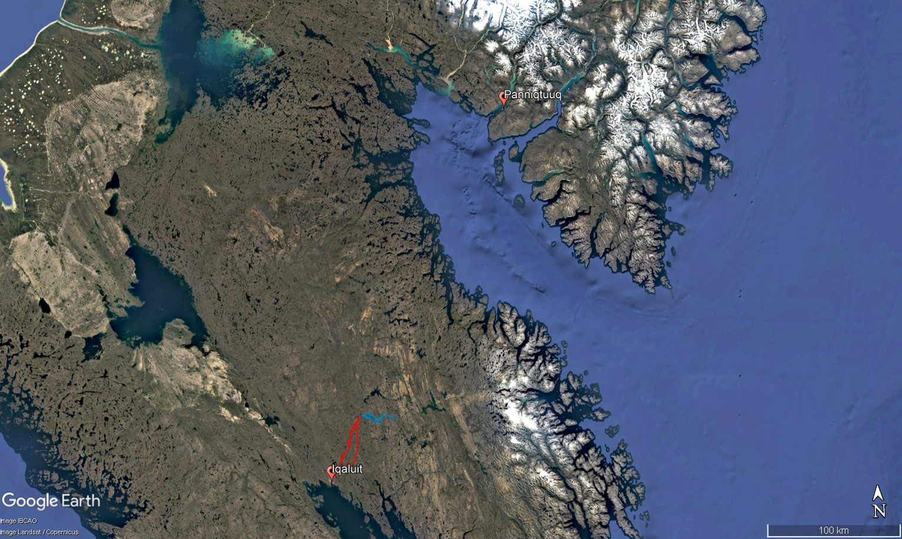

Slide 9
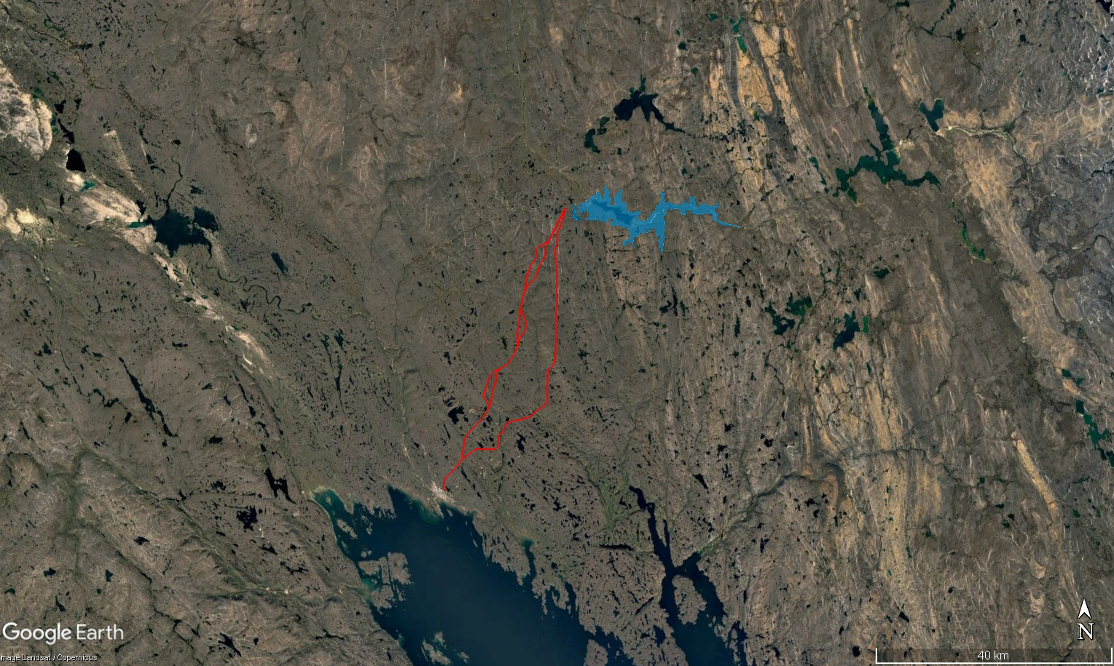
ᐃᒪᖓᓂ ᐊᐅᓚᐅᑎᖃᕐᕕᒃ ᐊᒻᒪᓗ ᓯᒥᖓ ᑰᒃ
Water Power Plant and Dam
ᐃᖃᓗᐃᑦ
ᑕᒪᐃᓐᓄᑦ ᐃᒥᖃᐅᑎᖃᕐᕕᖓ
IQALUIT
Main Reservoir
ᐃᓯᕐᕕᐊᓄᑦ ᐊᖁᑎ ᓂᕈᐊᖅᓯᒪᔪᓐᓇᖅᑐᑦ
Access Road Options

Slide 10



ᐅᕙᓃᑉᐳᒍᑦ
WE ARE HERE
ᓴᓇᔪᓕᕆᓂᖅ + ᐊᒃᑐᖅᓯᓃᑦ ᐱᕚᓪᓕᕈᑕᐅᕙᒃᑐᓪᓗ
ᖃᐅᔨᓴᕈᑕᐅᔪᓂᒃ ᓇᓗᓇᐃᔭᐃᓂᖅ
ᑲᔪᓯᔪᓐᓇᕐᒪᖔᑕ ᑲᔪᓯᔪᓐᓇᓐᖏᒻᒪᖔᑕᓘᓐᓃᑦ
ᐱᔪᓐᓇᐅᑎᑖᖅᑎᑦᑎᓂᖅ ᑮᓇᐅᔭᓂᒡᓗ ᐱᕙᒌᔭᖅᓯᒪᓂᖅ
ᓇᓗᓇᐃᕐᓗᒋᑦ ᐱᕕᖃᕐᑎᑦᑎᔪᑦ
ᐱᖁᑎᑦ ᐃᖏᕐᕋᓯᑎᑕᐅᓗᑎᒃ
ᓴᓇᓗᑎᒃ
1
2
3
4
5
6
Identify Opportunity
Feasibility
Engineering + Impacts and Benefits Assessment
Permitting and Financial Readiness
Construction
Asset Operation
ᓱᒃᑲᖅᑕᕐᓂᖓ
Project Phase
ᓱᕈᖅᓴᐃᓐᖏᑦᑐᓂᒃ ᐆᒻᒪᖁᑎᖃᐅᑎᒃᓴᓂᒃ ᕿᓂᖅᑕᐅᒃᑲᓐᓂᕈᓐᓇᖅᐸ?
ᖃᓄᕆᑦᑐᓂᒃ ᓱᕈᖅᓴᐃᓐᖏᑦᑐᑦ ᐆᒻᒪᖁᑎᖃᐅᑎᑦ ᐊᒻᒪᓗ ᓇᓂ?
ᐸᕐᓇᐅᑎᑦ ᐱᕚᓪᓕᕈᑎᒃᓴᓂᒃ ᐊᒥᖅᑳᖃᑎᖃᕐᓂᖅ ᐊᒻᒪ ᐊᒃᑐᐃᓗᐊᖅᑕᐃᓕᑎᑦᑎᓂᖅ ᑐᑭᖃᖅᐹᑦ, ᐱᓕᕆᐊᒃᓴᕐᓗ ᑐᓐᓂᖅᑯᑎᒋᔭᕆᐊᖃᖅᐱᑎᒎ ᓄᓇᕗᒻᒥ ᐊᕙᑎᓕᕆᔨᒃᑯᑦ ᑲᑎᒪᔨᖏᓐᓄᑦ?
ᐱᕈᖅᑎᑦᑎᔭᕆᐊᖃᖅᐱᑖ ᓴᓇᓂᕐᒧᑦ ᐱᓕᕆᐊᒃᓴᒥᒃ?
ᐃᓱᒪᓕᐅᕆᔭᕆᐊᓕᑦ
Decision Gate
Should clean energy be further explored?
What type of clean energy and where?
Do the plans for benefits sharing and impacts mitigation make sense, and should we submit the Project to NIRB?
Should we invest in building the Project?

Slide 11
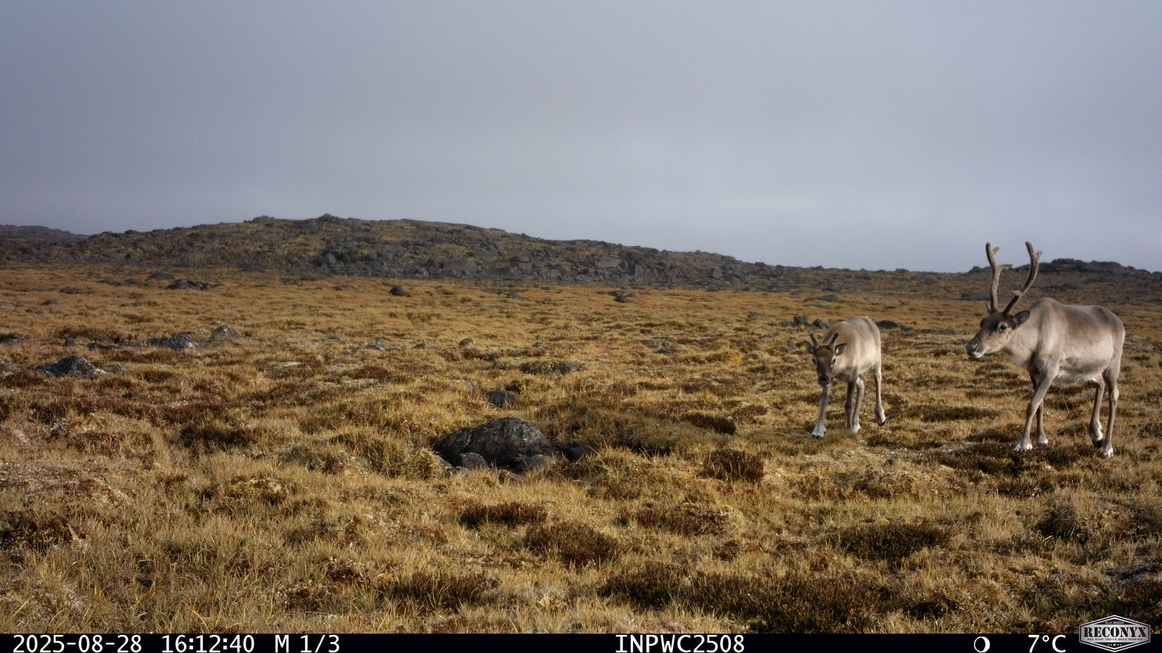
ᖃᓄᐃᒻᒪᑦ ᐅᕙᓃᑉᐱᑕ ᐅᓪᓗᓯ?
WHY ARE WE HERE TODAY?
ᑐᑭᓯᓇᖅᓯᑎᒋᐊᖅᖢᒍ ᐱᓕᕆᐊᖅ ᐅᓪᓗᒥ ᖃᓄᐃᓕᖓᓕᕐᒪᖔᑦ
1
To clarify where the project stands today
ᐃᓱᒫᓗᒋᔭᓯᑦ ᓈᓚᒡᓗᒋᑦ
2
To listen to your concerns
ᐅᓂᒃᑲᐅᓯᖃᕈᒪᓂᖅ ᐃᓐᓇᕗᑦ ᐃᒪᕐᒧᑦ ᐆᒻᒪᖅᑯᑎᖃᕐᓂᕐᒧᑦ ᐱᓕᕆᐊᖑᔪᒥᒃ ᐃᓄᒡᔪᐊᕐᒥ
To share the story of the Innavik Water Power Project in Inukjuak
3
Notes:
Speaker Notes –
First, we are not here to convince anyone to support this project today. Today is about dialogue, not decisions. We are here to listen to your concerns and questions.
Second, we want clarify where the project stands today, because there has been understandable confusion. We want to talk about how decisions will be made, and how your input matters in what happens next with the project. We want to hear about all your concerns. We are here to listen to you today.
Third, we brought Eric and Tommy from Inukjuaq to share the story of the Innavik Water Power Project.

Slide 12

ᐱᓕᕆᐊᒃᓴᐅᑉ ᖃᖓᒃᑰᕐᓂᐊᕐᓂᖓ
PROJECT TIMELINE
ᐃᓱᒪᓕᐅᕆᕕᖃᖅᑐᓯ
ᐱᖁᔭᕋᓛᑦ ᐊᖏᖅᑕᐅᓗᑎᒃ, ᑭᖑᓪᓕᖅᐹᖅᓯᐅᑎ ᓴᓇᔭᐅᔪᒧᑦ ᐊᖏᖅᑕᐅᓗᓂ
ᑕᒫᓃᑉᐳᒍᑦ! We are here!
Decision Window
Regulatory and Final Project Approval
ᒪᑐᐃᕐᓗᓂ ᐆᒻᒪᖁᑎᖃᕐᕕᐅᓕᕐᓗᓂ
ᑐᑭᓯᒋᐊᕈᑎᒃᓴᓂᒃ ᓄᐊᑦᑎᓂᖅ DATA COLLECTION
2030
FIRST POWER
ᐊᐅᓚᐅᓯᕆᔨᑦ ENGINEERING
ᓴᓇᔭᐅᓂᖓ CONSTRUCTION
2022
2023
2024
2025
2026
2027
2028
2029
2030
2031
2032
2033
Notes:
More than 20 years ago, Qulliq Energy Corporation (QEC) started looking at water power options at Qigirrijaarvik (Jaynes Inlet) and Nunngarut (Armshow River). Inuit rely heavily on both locations, with Nunngarut situated in a Territorial Park on Inuit-owned land, and camps and cabins at both proposed dam sites. Due to unresolved concerns about impacts, inadequate benefits-sharing, and costs that were too high for QEC to manage, the two-site proposal was rejected.
Hearing Inuit concerns and the strong desire to move away from diesel power, QIA took over the project in 2017. In 2020, as the renewable energy leader under the Qikiqtani Region’s Birthright Development Corporation, NNC started leading the project in collaboration with QIA.

Slide 13
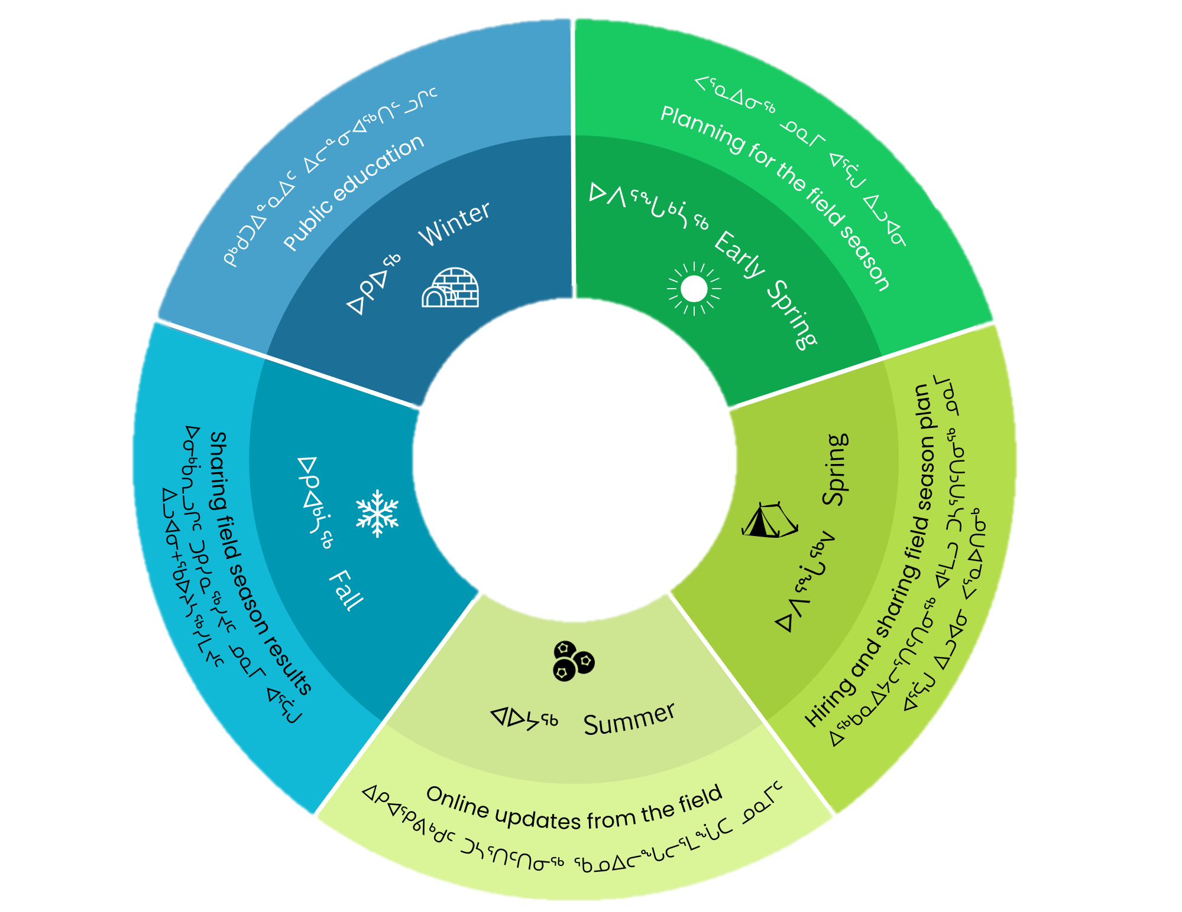
ᐃᓚᐅᑎᑦᑎᓂᕐᒧᑦ ᖃᓄᐃᓕᐅᕈᑕᐅᔪᒪᔪᖅ
ENGAGEMENT STRATEGY
ᓄᓇᕗᑦ ᓄᑭᒃᓴᐅᑏᑦ ᑯᐊᐳᕇᓴᒃᑯᑦ ᐊᑐᖃᑦᑕᖅᐳᑦ ᐊᕐᕌᒍᓕᒫᖅ ᐱᓕᕆᖃᑎᒌᖕᓂᕐᒥᒃ ᑐᕌᒐᖃᖅᖢᑎᒃ ᑐᓴᒐᒃᓴᓂᒃ ᑐᓴᐅᒪᑎᑦᑎᖃᑦᑕᕐᓂᕐᒥᒃ ᖃᑯᑎᒃᑯᑦ ᑐᓴᕐᕕᖃᕈᓐᓇᖅᑎᑦᑎᓪᓗᑎᒡᓗ ᐸᓐᓂᖅᑑᒥᐅᓂᒃ, ᐃᖃᓗᖕᒥᐅᓂᒃ ᐊᒻᒪ ᐱᔪᓐᓇᐅᑎᖃᖅᑐᓂᒃ
ᐊᕐᕌᒎᑉ ᐃᓚᐃᓐᓇᖓᓂ ᑲᑐᔾᔨᓪᓗᑎᒃᐱᕙᓪᓕᐊᑎᑦᑎᓂᖅ ᓄᓇᒥ ᐸᕐᓇᐅᑎᓂᒃ
ᓄᓇᓕᖕᓂ ᑲᑎᒪᑎᑦᑎᓂᖅ, ᖃᕆᑕᐅᔭᒃᑯᑦ ᑐᓴᒐᒃᓴᓂᒃ ᑐᓂᓯᖃᑦᑕᕐᓂᖅ
NNC uses a year-round engagement cycle with a goal of sharing information regularly and allowing for feedback from Panniqtuumiut, Iqalungmiut and Rightsholders
Seasonal co-development of field plans
Community meetings, online information sharing
Notes:
Our engagement cycle reflects the regular timing of our engagements for the next few field seasons.
The goal of the engagement cycle is to ensure we are sharing information regularly and Iqalungmiut & Panniqtuumiut have multiple opportunities throughout the year to share feedback on the Project.

Slide 14
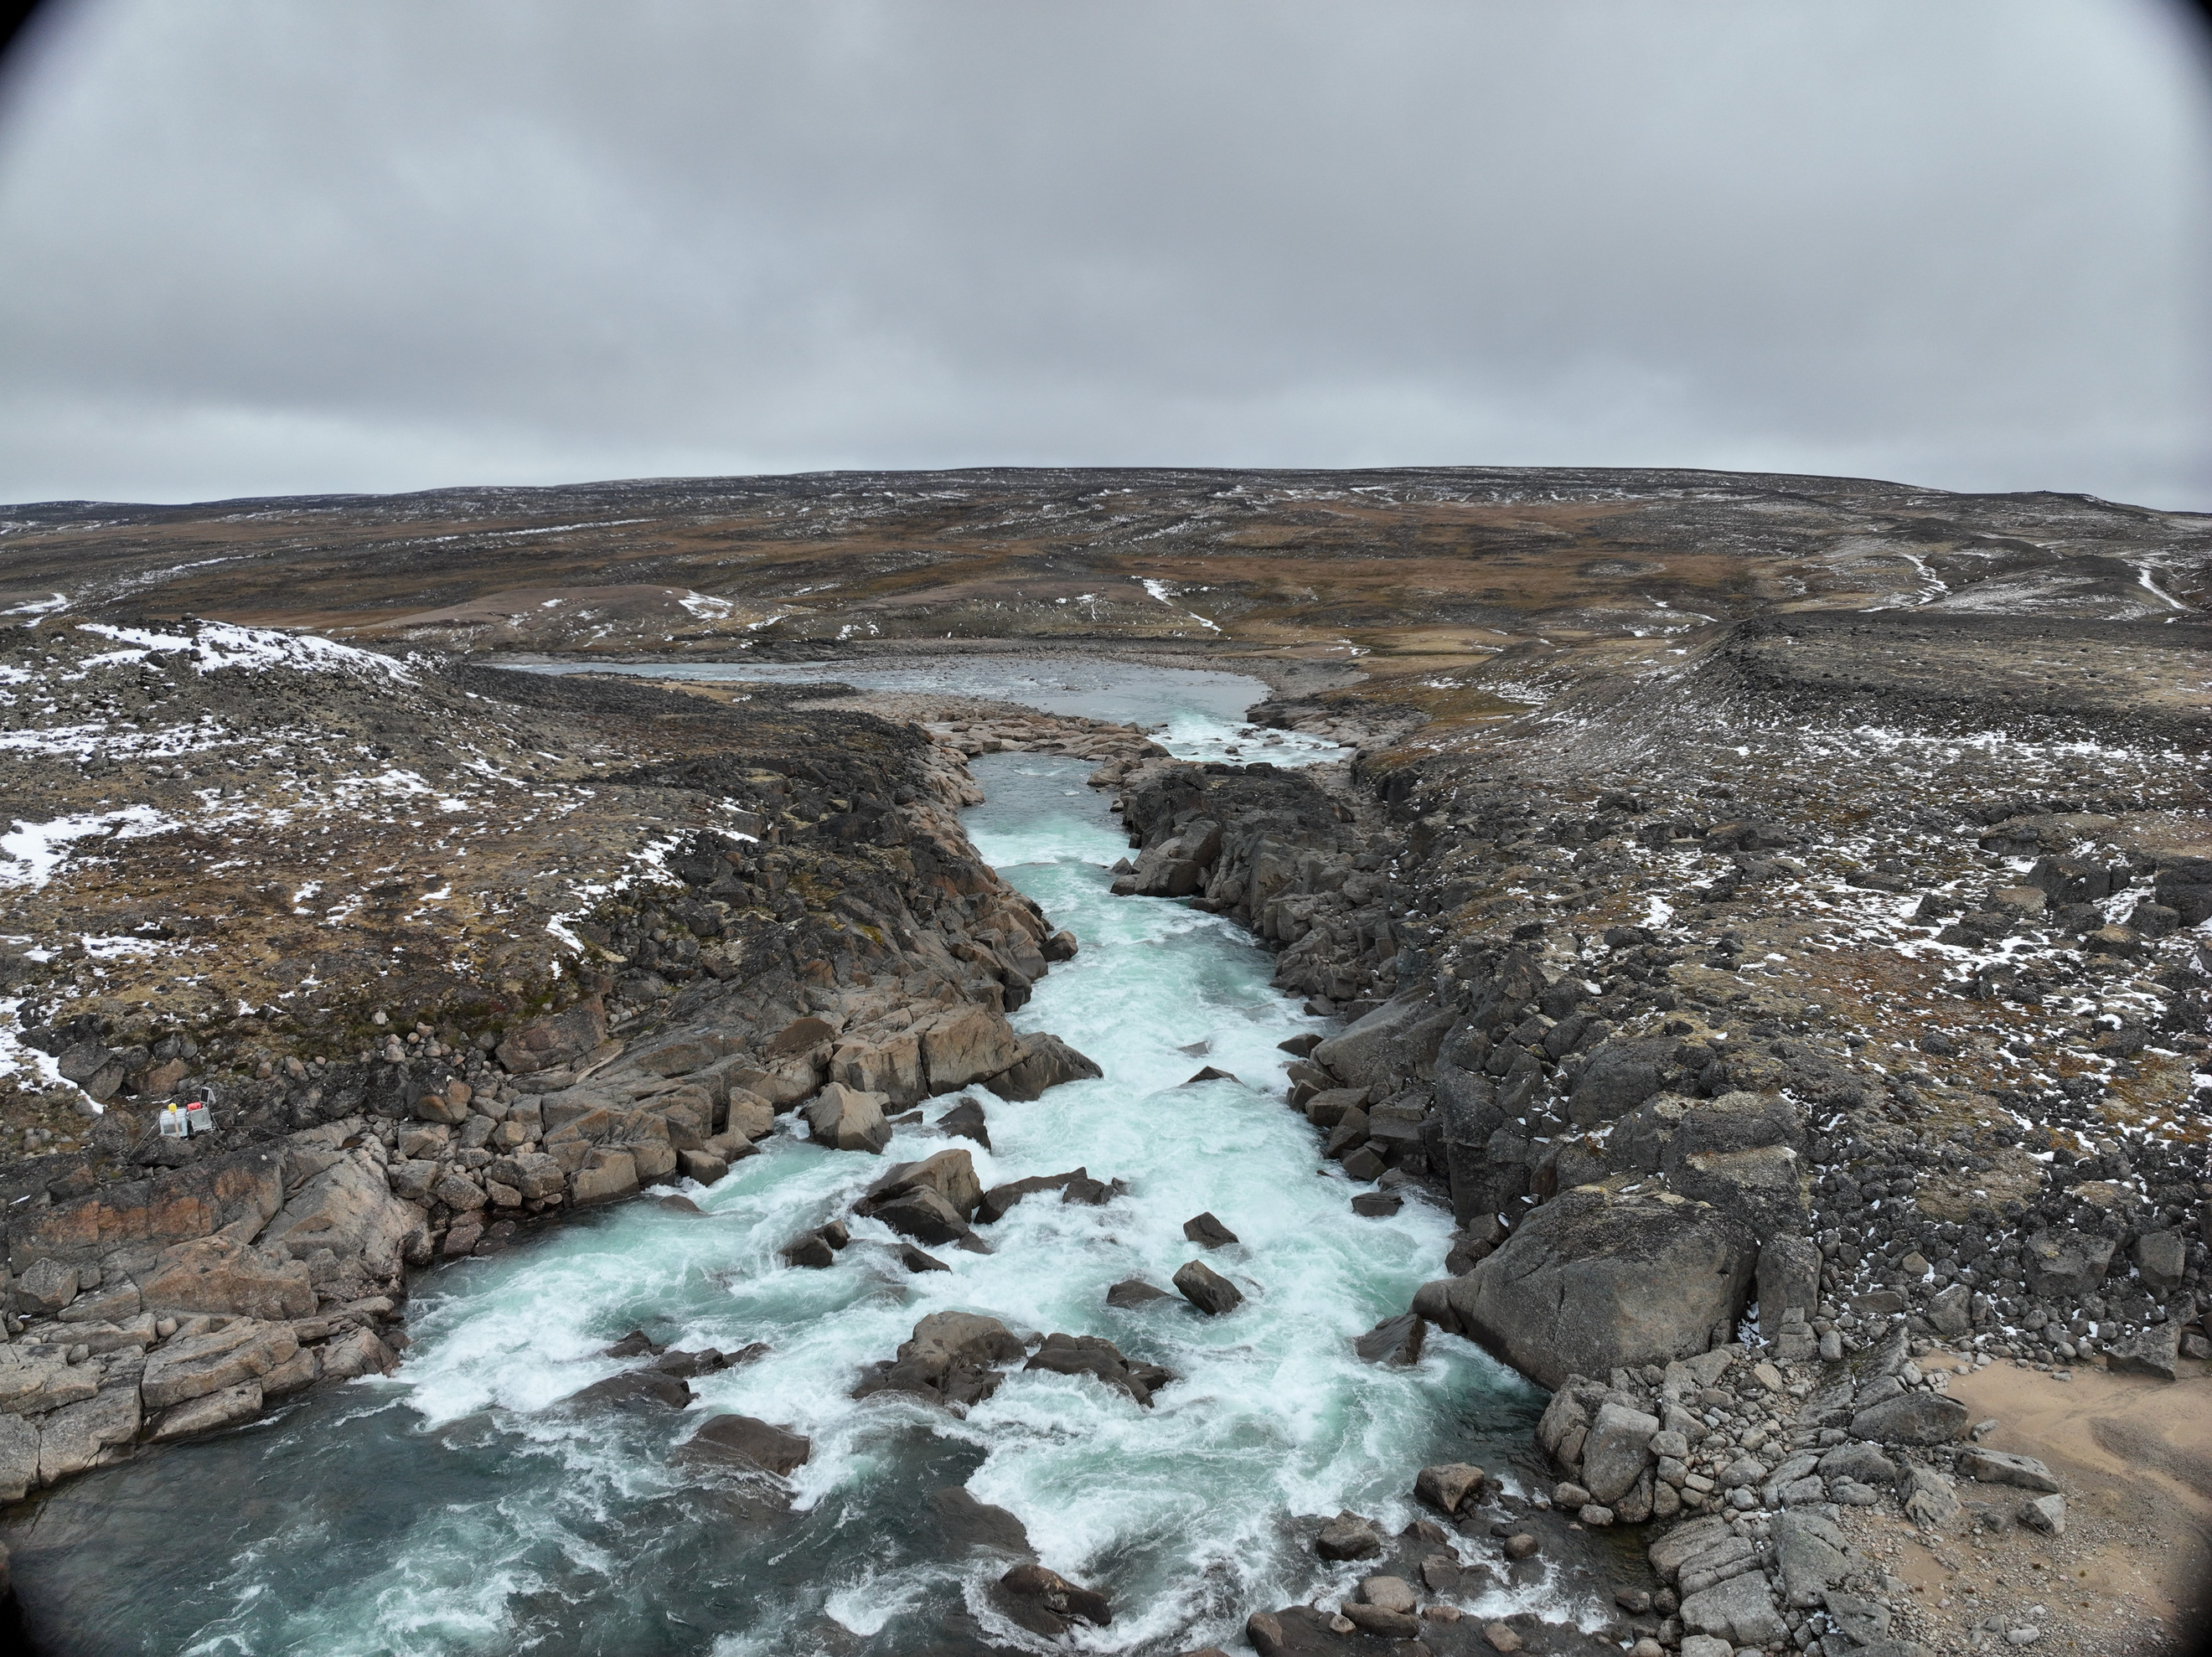

ᑭᓱᓂᒃ ᐱᔭᕇᖅᓯᓂᐊᕐᒪᖔᑦᑕ 2025-ᒥ
WHAT WE ACCOMPLISHED IN 2025
ᒐᕙᒪᑐᖃᒃᑯᓐᓂᑦ ᑮᓇᐅᔭᖃᖅᑎᑕᐅᓪᓗᑎᒃ ᐃᑲᔪᖅᑐᐃᔾᔪᑎᒃᓴᓂᒃ ᓯᓚᒥ ᖃᐅᔨᓴᖅᑕᐅᓂᑯᐃᑦ ᑲᑎᖅᓱᖅᑕᐅᕙᓪᓕᐊᓂᖏᓐᓄᑦ
ᐋᖅᑭᒃᓱᐃᖃᑎᖃᖅᖢᑎᒃ ᐊᐅᔭᒃᑯᑦ ᓄᓇᒥ ᑎᑎᕋᖅᓯᒪᔪᓂᒃ ᑲᑎᖅᓱᐃᓂᕐᒧᑦ ᐱᕙᒌᔭᖅᑕᐅᓯᒪᔪᓂᒃ ᐊᖑᓇᓱᒃᑐᓕᕆᔨᒃᑯᑦ
ᐱᐊᓂᒃᓯᓚᐅᖅᑐᖅ ᓯᕗᓪᓕᖅᐹᒥ ᑎᑎᖅᑲᓂᒃ ᑲᑎᖅᓱᕐᓇᐅᑎᓪᓗᒍ
ᓄᓇᒥᐅᑕᐃᑦ ᐊᒻᒪᓗ ᓂᕐᔪᑏᓪᓗ
ᓄᓇᒥ ᖃᐅᔨᓴᕐᓂᖅ
ᐃᑦᑕᕐᓂᓴᓕᕆᓂᖅ
ᐃᒪᕐᒥᐅᑕᓕᕆᔩᑦ
Secured federal funding to support field data collection
Shared summer field data collection plans with HTAs prior to season
Completed the first data collection season
Terrestrial and Wildlife
Ground Studies
Archaeology
Aquatics

Slide 15

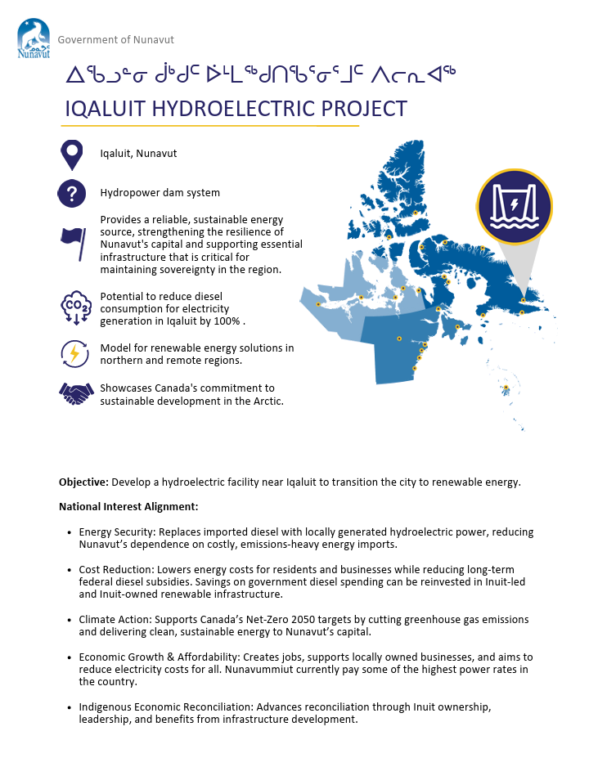
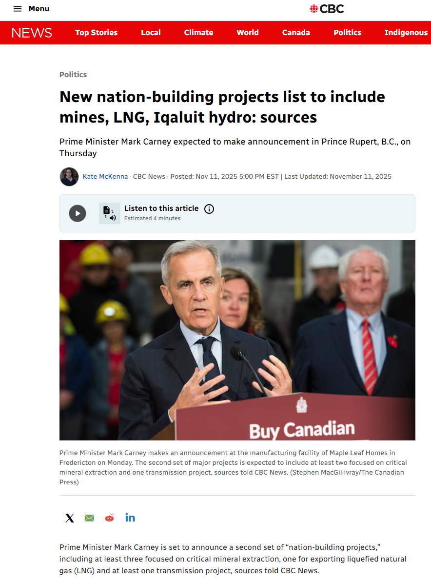
ᑲᓇᑕᒥ-ᐱᕈᖅᑎᑦᑎᕙᓪᓕᐊᓂᕐᒧᑦ ᐱᓕᕆᐊᒃᓴᑦ ᑎᑎᕋᖅᓯᒪᔪᑦ
NATION-BUILDING PROJECTS LIST

Slide 16

ᑲᓇᑕᒥ-ᐱᕈᖅᑎᑦᑎᕙᓪᓕᐊᓂᕐᒧᑦ ᐱᓕᕆᐊᒃᓴᑦ ᑎᑎᕋᖅᓯᒪᔪᑦ
NATION-BUILDING PROJECTS LIST
ᑖᓐᓇ ᑐᓴᒐᒃᓴᖅ:
This announcement:
ᐱᓕᕆᐊᒃᓴᐅᑉ
ᐊᖏᕈᑎᖃᙱᓚᖅ ᐱᓕᕆᐊᒥᒃ
ᖄᖏᐅᑎᕙᙱᓚᖅ ᐃᓄᐃᑦ ᐱᔪᓐᓇᐅᑎᖏᓐᓂᑦ ᐅᕝᕙᓗᓐᓃᑦ ᐃᓄᐃᑦ−ᐋᖅᑭᒃᓯᒪᓕᖅᑎᑕᐅᔪᓂᒃ
ᖄᖏᙱᖦᖢᓂ ᓄᓇᓕᖕᓂ ᐃᓱᒫᓘᑕᐅᔪᓂᒃ
ᖄᐃᖑᑎᕙᙱᑦᑐᑦ ᓄᓇᕗᑦᒥ ᐊᕙᑎᓕᕆᔨᒃᑯᑦ ᑲᑎᒪᔨᖏᑕ ᐱᓕᕆᔾᔪᓯᖏᓐᓂᒃ
ᐅᖃᙱᑦᑐᒍᑦ ᐱᓕᕆᐊᖅ ᖓᕙᒪᑐᖃᒃᑯᓐᓄᑦ ᐊᐅᓚᑕᐅᓂᖓᓐᓂᒃ
Does not approve the project
Does not fast-track the project
Does not override Inuit rights or Inuit decision-making
Does not bypass community concerns
Does not bypass the Nunavut Impact Review Board process
Does not mean the project is under federal control

Slide 17
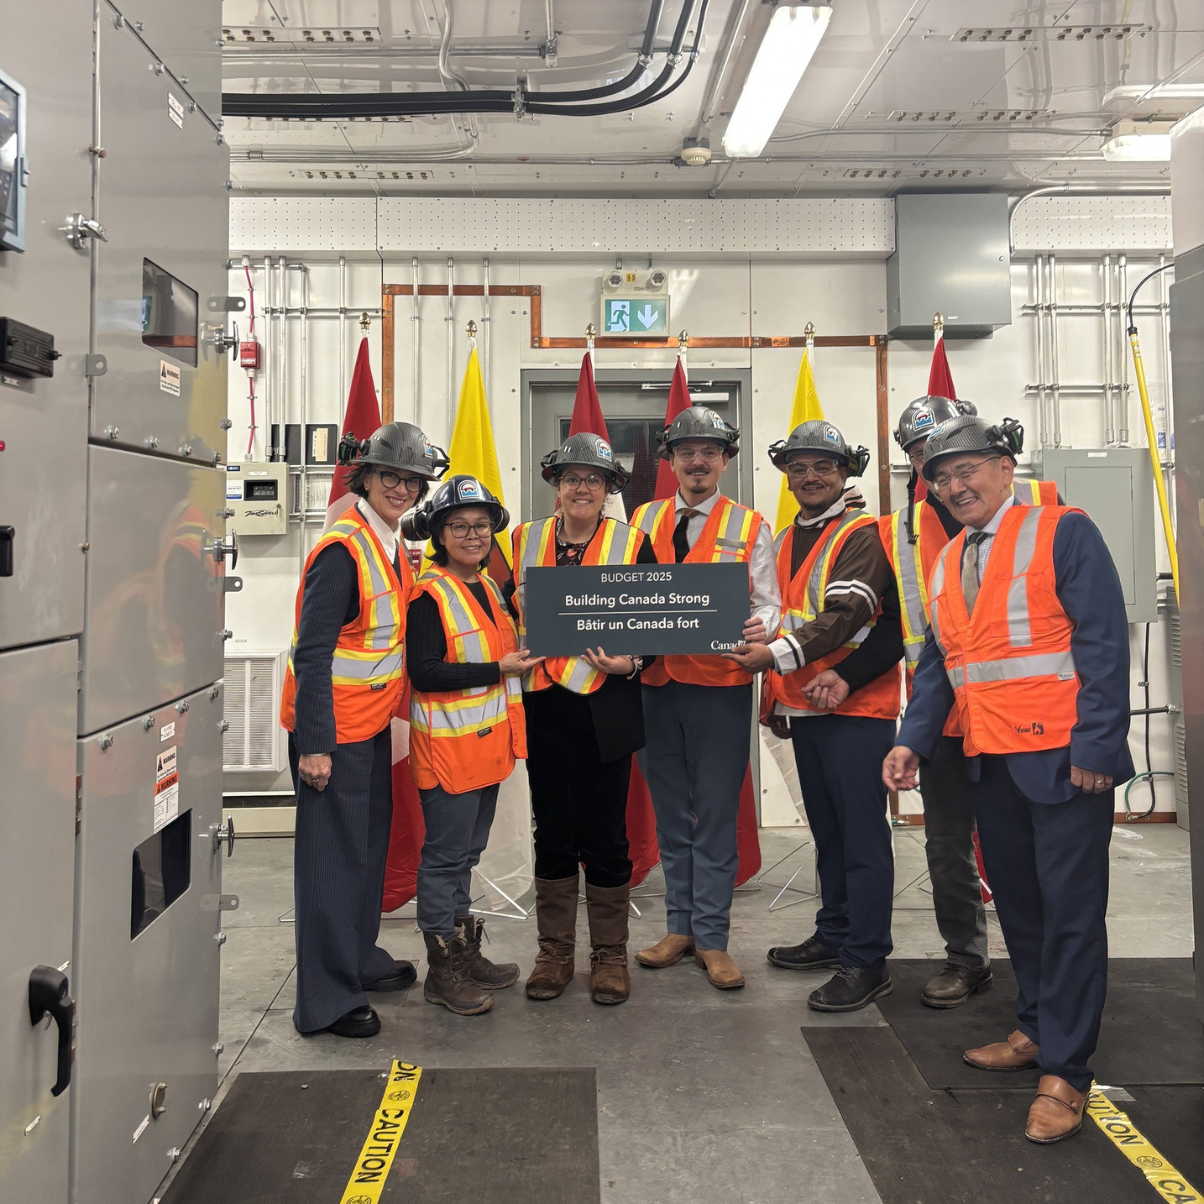

ᑲᓇᑕᒥ-ᐱᕈᖅᑎᑦᑎᕙᓪᓕᐊᓂᕐᒧᑦ ᐱᓕᕆᐊᒃᓴᑦ ᑎᑎᕋᖅᓯᒪᔪᑦ
NATION-BUILDING PROJECTS LIST
ᑖᓐᓇ ᑐᓴᖅᑎᑦᑎᔾᔪᑎ ᖃᓄᖅ ᑐᑭᖃᕐᒪᖔᑦ:
ᐱᓕᕆᐊᖅ ᐃᓕᓴᕆᔭᐅᓯᒪᔪᖅ ᑲᓇᑕᓕᒫᒥ ᐱᒻᒪᕆᐊᓘᓂᖓᓂᒃ ᐱᔪᓐᓇᖅᑎᑦᓯᑎᓪᓗᒍᓗ ᐆᒻᒪᖅᑯᑎᓂᒃ ᐊᑦᑕᓇᔾᔭᐃᖅᓯᒪᓂᕐᒥᒃ ᐊᒻᒪᓗ ᐃᓄᐃᑦ ᓇᒻᒥᓂᖁᑎᖃᕐᓂᖏᓐᓂᒃ
ᓱᒃᑲᓂᖅᓴᒥᒃ ᒐᕙᒪᑐᖃᒃᑯᑦ ᐊᖏᖅᓯᕕᒃᓴᖃᕈᓐᓇᖅᑐᑦ
ᐃᑲᔫᑎᖃᕐᓂᖅᓴᐅᓗᑎᒃ = ᕿᒥᕐᕈᔭᐅᓂᖅᓴᐅᓗᑎᒃ ᐃᓄᐃᑦ ᐊᕙᑎᓕᕆᓂᕐᒧᓪᓗ ᐃᓱᒫᓘᑕᐅᔪᑦ ᑲᒪᒋᔭᐅᑦᑎᐊᕋᓗᐊᕐᒪᖔᑕ
ᐊᖏᖅᓯᒪᓂᐅᔪᑦ ᐱᔪᓐᓇᐅᑎᖃᖅᑐᓄᑦ ᐊᒻᒪᓗ ᑭᒃᑯᑐᐃᓐᓇᕐᓄᑦ ᐃᓚᐅᑎᑦᑎᓂᕐᒧᑦ, ᐊᒻᒪᓗ ᓄᓇᓕᐅᔪᑦ ᐅᖃᐅᓯᒃᓴᖏᑦ, ᑕᐃᒪᐃᓕᖓᐃᓐᓇᕐᓂᐊᖅᑐᑦ
What the announcement means:
The Project is recognized as nationally significant while enabling energy security and Inuit sovereignty
Could have a quicker federal approval timeline
More resources = More scrutiny to ensure Inuit and environmental concerns are addressed
Commitments to Rightsholder and public engagement, and community inputs, remain the same
Notes:
Speaker Notes – We want to acknowledge that the recent announcement caused a lot of concern and frustration in Panniqtuuq.
Many people understood that announcement to mean the project was already approved or moving ahead no matter what. We understand why that would feel upsetting, especially when it affects land, water, wildlife, and your community.
We also recognize that we could have explained things more clearly earlier, and that the way information was shared added to the concern. We take responsibility for that, and we want to do better.
The Iqaluit Hydropower Project is still in the planning stage. Studies are ongoing. No final decisions have been made.
What is also important to say clearly is what has not
happened.
The project is not approved.
Construction is not approved.
Funding for construction is not approved
The project is not guaranteed to proceed.
Nothing is moving forward without more work, more information, and more conversations like this one.

Slide 18

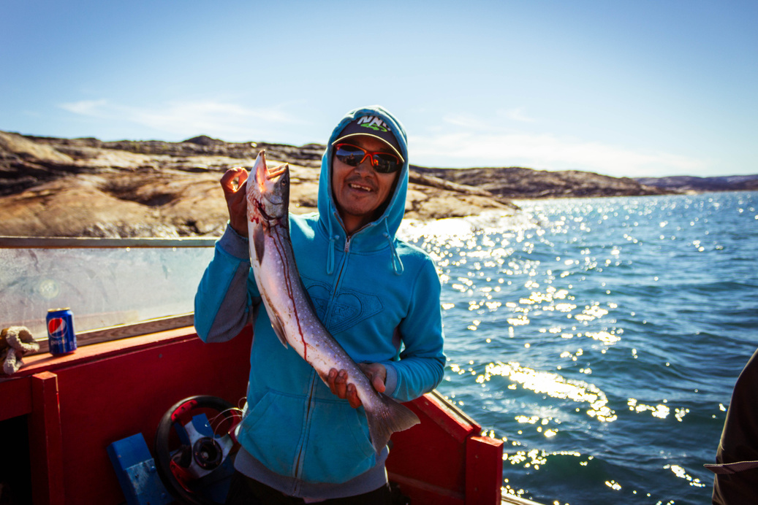
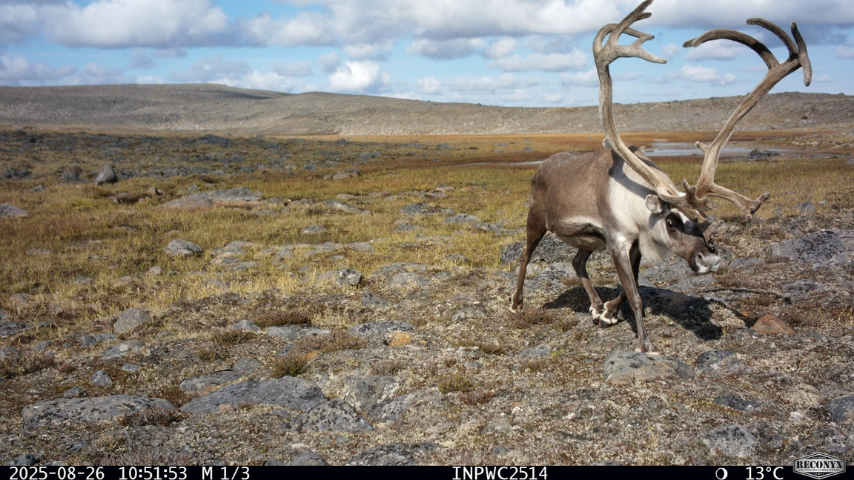
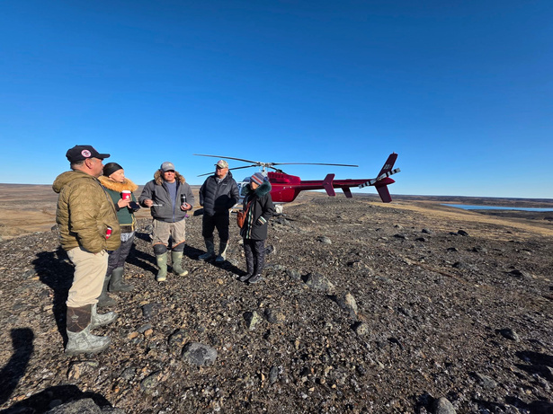
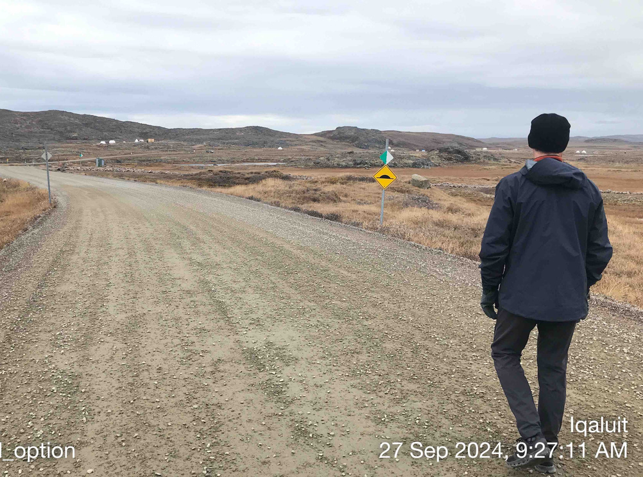
ᐃᓱᒫᓘᑕᐅᔪᑦ ᑐᓴᖅᓯᒪᔭᕗᑦ
CONCERNS WE HAVE HEARD
ᐊᒃᑐᐃᓂᖃᕐᓂᐊᖅᑐᖅ ᐃᖃᓗᖕᓄᑦ ᓂᕐᔪᑎᓄᒡᓗ
ᐱᓕᕆᐊᖅ ᐃᑲᔫᑎᖃᔾᔮᙱᑦᑐᖅ
ᐸᖕᓂᕐᑑᖅ ᐃᓚᓕᐅᔾᔭᐅᓚᐅᙱᑦᑐᖅ ᐃᓂᒃᓴᒥᒃ ᓂᕈᐊᖅᑐᖃᖅᑎᓪᓗᒍ
ᑰᖓ ᐊᓯᔾᔨᕐᓂᐊᖅᑐᖅ
There will be changes to the river
There will be impacts on fish and wildlife
The Project will not provide benefits
Panniqtuuq was not included in the site selection

Slide 19
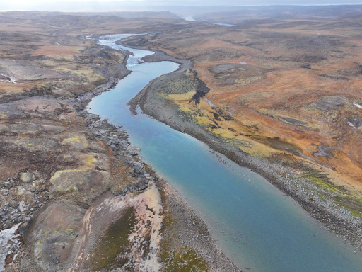
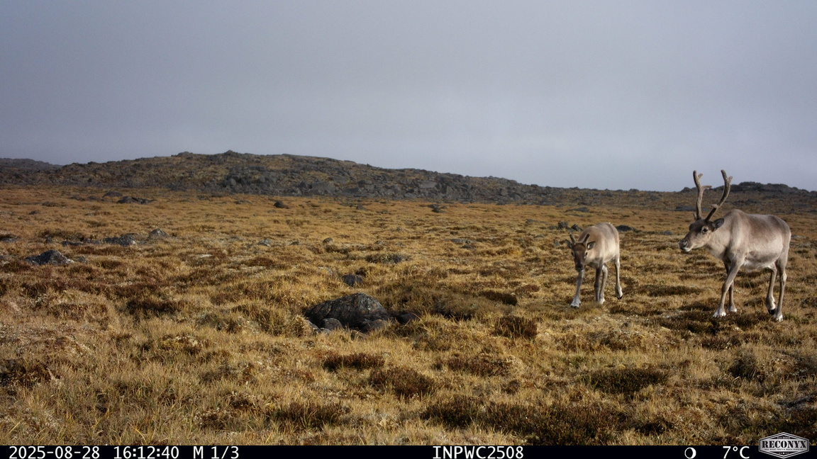
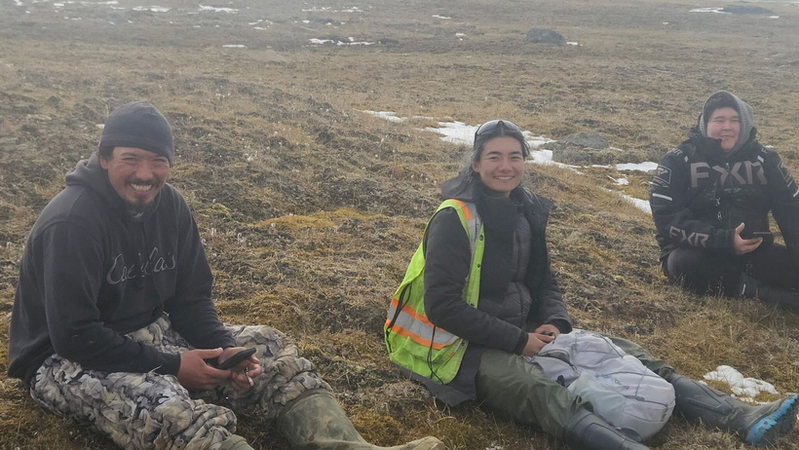
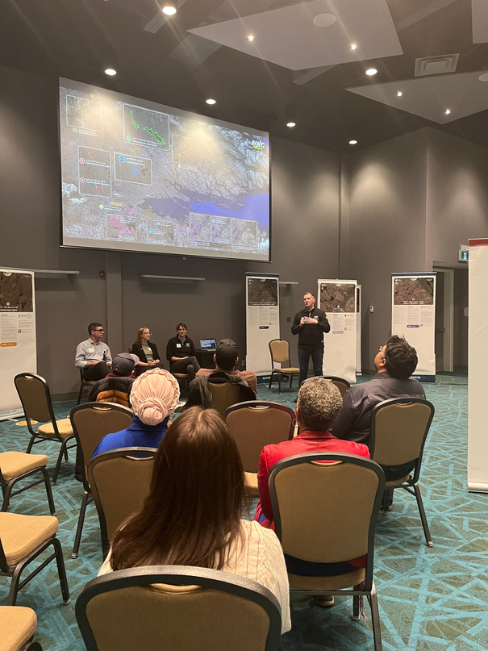
ᐃᓱᒫᓘᑕᐅᔪᓂᒃ ᑲᒪᒋᔭᖃᕐᓂᖅ
ADDRESSING CONCERNS
ᑰᑉ ᑰᖕᓂᖓ ᐃᖏᕐᕋᑦᑎᐊᕐᓂᖅᓴᐅᓂᐊᖅᑐᖅ ᑰᖕᒧᑦ
ᐃᖃᓗᖕᓂ ᐊᒻᒪ ᐆᒪᔪᓂᒃ ᖃᐅᔨᓴᕐᓂᖅ ᑲᔪᓯᓂᐊᖅᐳᑦ 2026ᒧᑦ ᑎᑭᖦᖢᒍ ᑐᑭᓯᓇᓱᒡᓗᑎᒃ ᖃᓄᑐᐃᓐᓇᖅ ᐊᓯᔾᔨᑐᐃᓐᓇᕆᐊᓕᖕᓂᒃ. ᐃᖃᓗᐃᑦ ᐅᓄᕐᓂᖏᑦ ᐅᓄᖅᓯᕚᓪᓕᕈᓐᓇᖅᑐᑦ.
ᓄᓇᕗᑦ ᓄᒃᑭᒃᓴᐅᑏᑦ ᑯᐊᐳᕇᓴᒃᑯᑦ ᐱᓕᕆᖃᑎᖃᐃᓐᓇᕐᓂᐊᖅᐳᑦ ᐸᖕᓂᕐᑑᕐᒥ ᐊᒻᒪ ᐃᖃᓗᖕᓂ
ᐱᓕᕆᐊᖅ ᐃᑲᔪᑎᖃᕐᓂᐊᖅᑐᖅ ᐃᖃᓗᐃᑦ ᐸᖕᓂᕐᑑᕐᒧᑦ
The river flow will become more consistent downstream
Fish and wildlife studies continue through 2026 to understand any potential changes. Fish populations could increase.
The Project will provide benefits to Iqaluit and Panniqtuuq
NNC will continue to engage with Panniqtuuq and Iqaluit

Slide 20



ᖃᓄᖅ ᓂᐲᑦ ᑐᓴᖅᑕᐅᑎᑦᑐᓐᓇᕐᒪᙶᖅᐱᐅᑦ
WAYS YOU CAN MAKE YOUR VOICE HEARD
ᐃᓄᐃᑦ ᐅᖃᐅᔾᔨᒋᐊᖅᑏᑦ ᑲᑎᒪᔨᕋᓛᖏᑦ
ᕿᑭᖅᑕᓂ ᐃᓄᐃᑦ ᑲᑐᔾᔨᖃᑎᒌᖏᑕ ᓄᓇᓕᓐᓂ ᑐᓴᐅᒪᑎᑦᑎᔨᖓ
ᐱᓕᕆᖃᑎᒌᓐᓂᕐᒧᑦ ᐊᖏᖃᑎᒌᒍᑎᒥᒃ ᐋᔩᖃᑎᒌᓐᓂᕐᒧᑦ ᑲᑎᒪᔨᕋᓛᑦ
ᐃᓅᓯᓕᕆᓂᕐᒧᑦ ᑮᓇᐅᔭᓕᐅᕋᓱᐊᕐᓂᕐᒧᑦ ᖃᐅᔨᓴᕐᓂᖅ 2026-ᒥ
ᑲᓲᑎᓯᒪᓗᑎᑦ ᖃᕆᑕᐅᔭᒃᑯᑦ ᑐᑭᓯᒋᐊᕐᕕᑦᑎᒍᑦ:
ᖃᕆᑕᐅᔭᒃᑯᑦ ᑎᑎᕋᕐᕕᒋᓗᑎᒍᑦ:
Inuit Advisory Committee
QIA Community Liaison Officer
Partnership agreement negotiation committee
Socioeconomic Assessment in 2026
Connect through our website:
Send us an email:
nunavutcleanenergy.com
nunavutcleanenergy.com
nnc@qcorp.ca
nnc@qcorp.ca

Slide 21
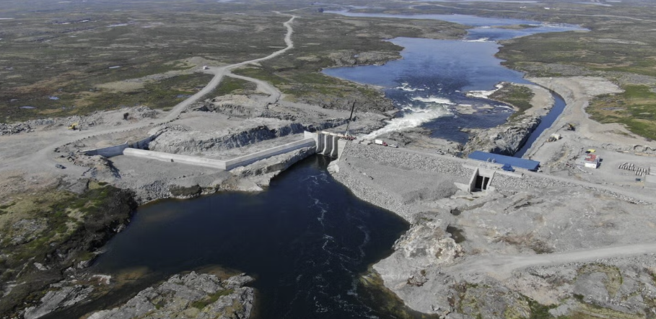
ᓄᖅᑲᖓᓚᐅᑲᒃᑎᓪᓗᒋᑦ
AFTER THE BREAK
ᐅᓂᒃᑳᖅᑐᐊᖅ ᐃᓐᓇᕕᖕᒥ ᐃᒪᕐᒧᑦ ᐆᒻᒪᖅᑯᑎᓕᐅᕐᓂᒧᑦ ᐱᓕᕆᐊᖅ!
Story of the Innavik water power project!

Slide 22
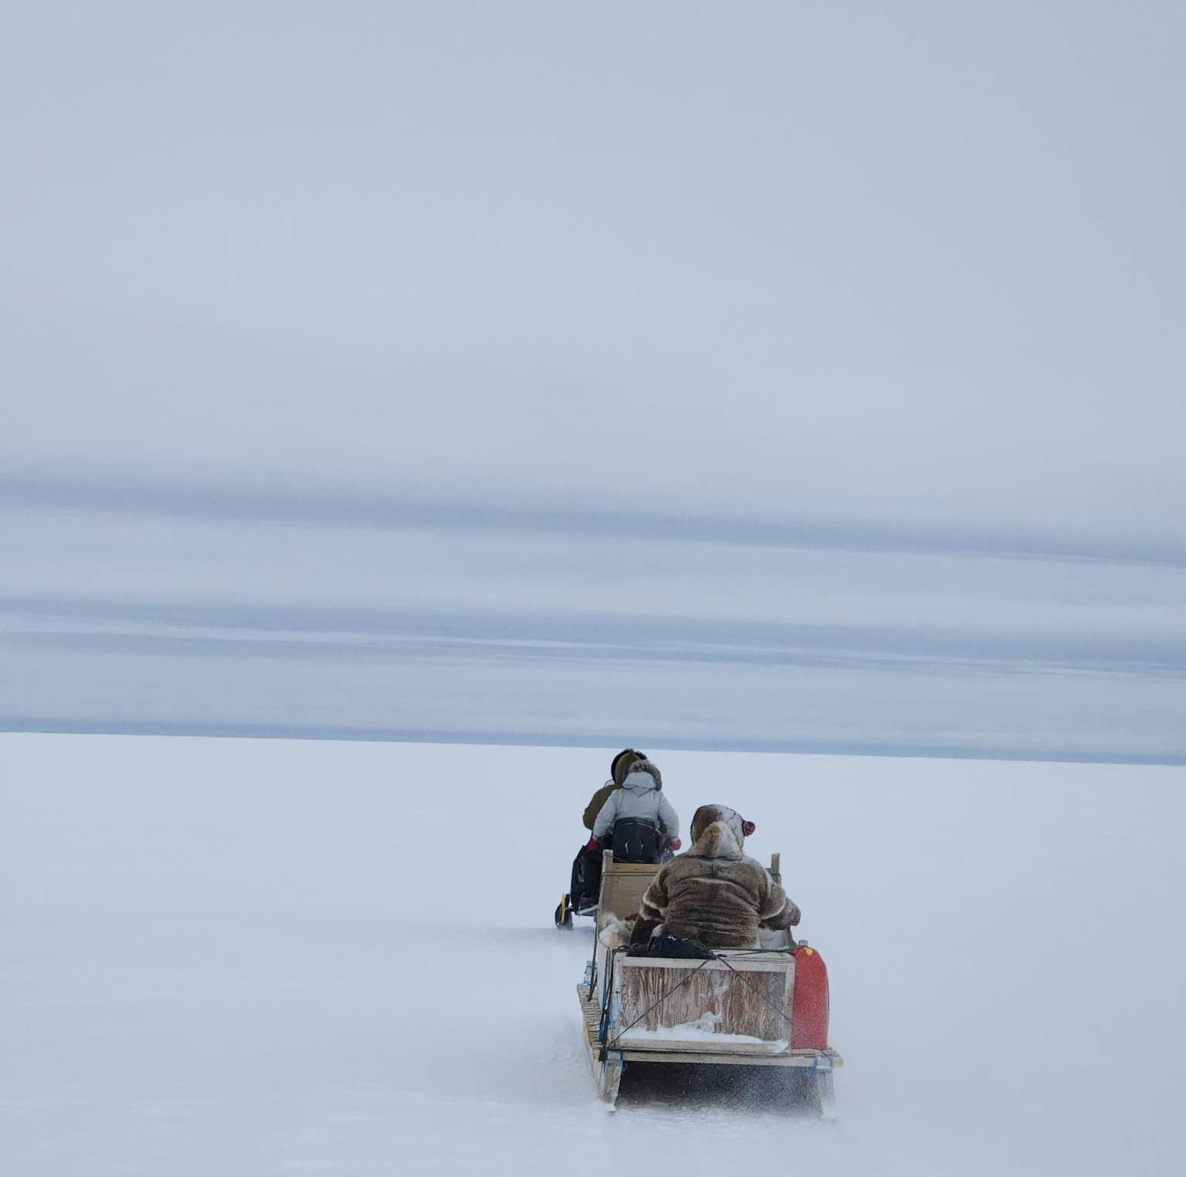

ᑭᖑᓪᓕᕐᒥᒃ ᐱᓕᕆᐊᖑᔪᒃᓴᖅ
NEXT STEPS
ᐃᓚᐅᑎᑦᑎᓂᖅ ᓄᓇᓕᖕᒥᐅᓂᒃ ᐊᒻᒪ ᐱᔪᓐᓇᐅᑎᖃᖅᑐᓂᒃ ᑐᓴᐅᒪᑎᑦᑎᕙᒃᐳᖅ ᖃᓄᐃᓕᐅᕐᓂᓕᒫᓂᒃ. ᐅᖃᖃᑎᒌᒃᑲᓐᓂᕆᐊᖃᓕᕌᖓᑕ ᐅᕝᕙᓘᓐᓃᑦ ᐊᓯᔾᔨᕆᐊᖃᓕᕌᖓᑕ, ᖃᓄᐃᓕᐅᖅᑎᑦᑎᒃᑲᓐᓂᖃᑦᑕᖅᑐᒍᑦ ᑲᑎᒪᓂᐅᔪᓂᒡᓗ, ᑭᓇᐅᒐᓗᐊᕈᓂ ᓂᐱᖏᑦ ᑐᓴᖅᑕᐅᔪᓐᓇᖁᓪᓗᒋᑦ.
ᓄᓇᕗᑦ ᓄᒃᑭᒃᓴᐅᑏᑦ ᑯᐊᐳᕇᓴᒃᑯᑦ ᐅᑎᓛᖅᑐᑦ ᑕᖅᑭᐅᓛᖅᑐᒥ ᓯᓚᒥ ᖃᐅᔨᔭᒥᓂᒃ ᑐᓴᖅᑎᑦᑎᔭᖅᑐᕐᓗᑎᒃ.
ᐅᐱᕐᙶᖑᓛᖅᑐᖅ ᐱᓕᕆᖃᑎᖃᓛᖅᐳᒍᑦ ᐸᖕᓂᖅᑑᑉ ᐊᒻᒪ ᐊᒪᕈᖅ ᐊᖑᓇᓱᒃᑎᓕᕆᔨᖏᓐᓂᒃ ᐸᕐᓇᐃᓗᑎᒃ 2026ᒥ ᓄᓇᒥ ᐱᓕᕆᓂᐊᕐᓂᕐᒧᑦ ᐸᕐᓇᐅᑎᒥᒃ.
Engagements keep community members and Rightsholders up to date every step of the way. When more discussion or changes are needed, we hold additional events and sessions, making sure everyone has an opportunity to have their voices heard.
NNC will return next month to share field season findings.
This spring we will work with the Panniqtuuq and Amaruq HTAs to co-develop the 2026 field work plan.

Slide 23
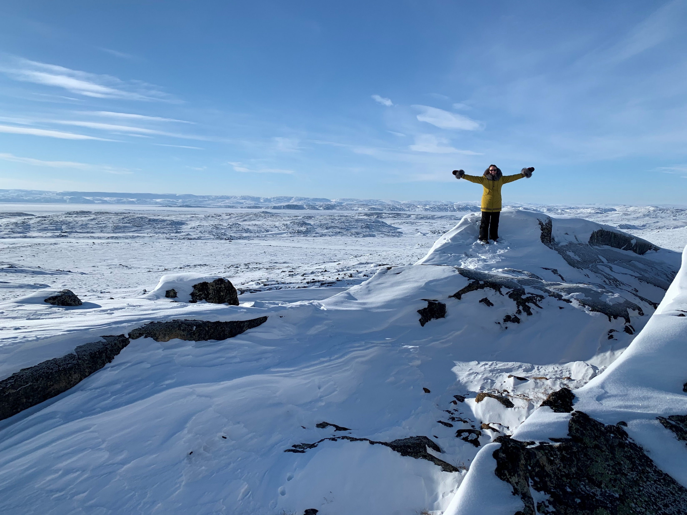


ᖁᔭᓐᓇᒦᒃ
Qujannamiik
Thank You
ᑐᓴᕈᒪᕗᒍᑦ ᐃᓕᔅᓯᓐᓂᒃ
WE LOVE TO HEAR FROM YOU
nnc@qcorp.ca
www.nunavutcleanenergy.ca
867-979-8400

